Slide 1
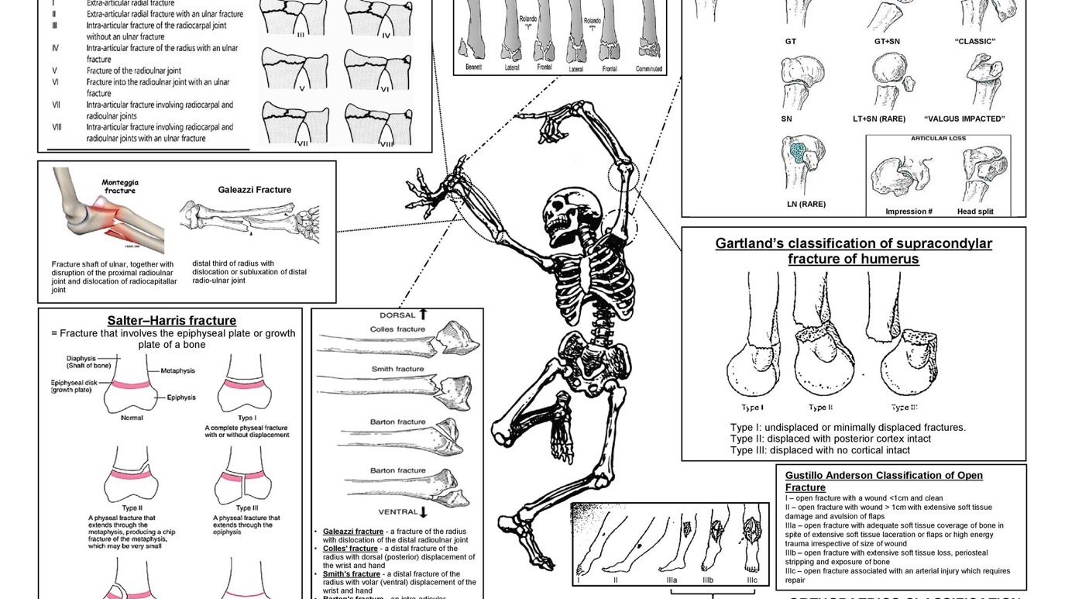
Uncertainty in Diagnosis: Asserting Classification
Helene Scott-Fordsmand
Carlsberg Postdoctoral Fellow, History and Philosophy of Science, University of Cambridge / Research Fellow, Clare Hall / Director of studies, Gonville & Caius

Slide 2
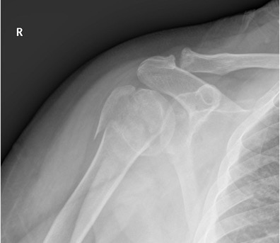
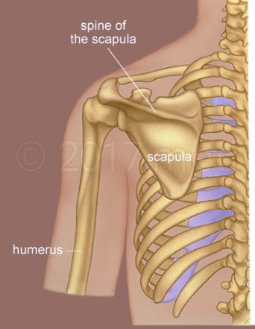

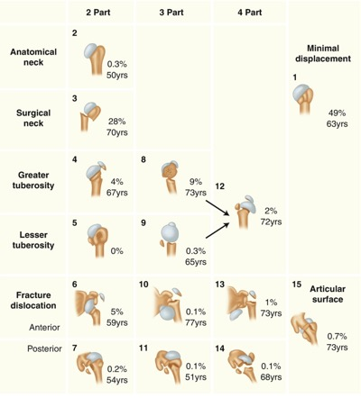
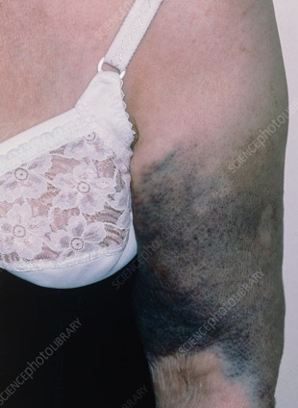

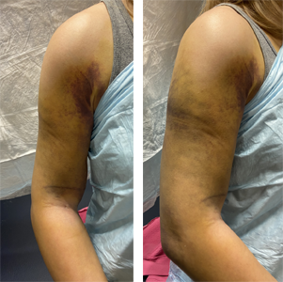

(Re)presenting broken shoulders
>10mm or 45°

Slide 3





Naming Disorders
ADHD
Andersen has ADHD
?
?
Diagnostic categories are names for disorders. They refer to (descriptions of) states of affairs in the world.
Andersen

Slide 4
Patient bodies are hard to know
Symptoms and sign express themselves differently in different bodies, lives, and cultures.
There are temporal and ethical limits to what tests we can do to them.
Issues of continuity (ontic)
Random 10mm. Unclear bounds between anatomical parts/anatomical variation.
Issues of uncertainty (epistemic)
Angling of the shoulder. Movement of the tissue. Unclear tissue.

Slide 5
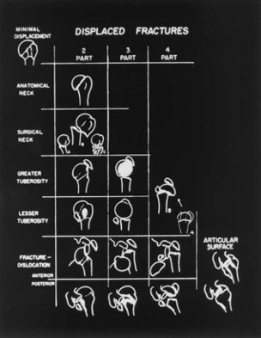
Classification as ‘mental pictures’
“It’s just a box that we made up, and then a lot of things fit into it.”
(lead shoulder surgeon, on ‘impingement’)
“not meant to be a numerical classification that is oversimplified or patterned for easy roentgen classification, but rather is a “concept” or mental picture of the actual pathomechanics and pathoanatomy.” (Neer 2002)
‘There are some [classifications] you use pretty often, and then there are some that you don’t use. Because you find out what is important and what is not important. That is probably why when I was younger, I always looked them [classifications] up for everything because back then you didn’t know what was important and what wasn’t’
(surgeon in training)

Slide 6

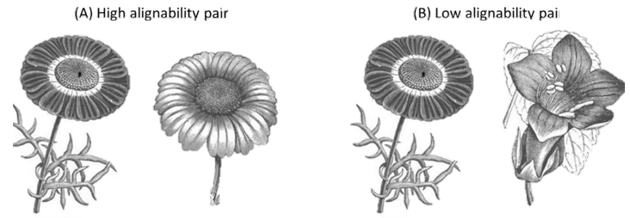
What can we do with analogue models?
1
2
Gentner & Maravilla (2017)
PREDICTING
SEEING SALIENT FEATURES

Slide 7
Alternative: Modelling Disorders
NAMES are linguistic tools that help us point towards something
MODELS are epistemic tools that help us reason about something. They are self-contained systems with some representational force for their target. They are interest-dependent/partial.
to argue that being a name – or correctly naming – is not the primary clinical function of diagnostic categories.
to resist some of the intuitive implications of the naming conception.

Slide 8
(Re)presenting broken shoulders
>10mm or 45°
Thank you for listening!
For future thoughts: hs747@cam.ac.uk or @HScottFordsmand
Questions?
Comments?
Statements?

Slide 9
References and other relevant texts
Bartha, Paul. 2022. ‘Analogy and Analogical Reasoning’. In The Stanford Encyclopedia of Philosophy, edited by Edward N. Zalta, Summer 2022. Metaphysics Research Lab, Stanford University.
Brochhausen, Mathias. 2017. ‘Classificatory Challenges in Physical Disease’. In The Routledge Companion to Philosophy of Medicine, edited by Miriam Solomon, Jeremy R. Simon, and Harold Kincaid, 180–91. Routledge Philosophy Companions. New York: Routledge, Taylor & Francis Group.
Brorson, Stig. 2021. ‘Evidence-Based Orthopedics and the Myth of Restoring the Anatomy’. Acta Orthopaedica 92 (5): 505–6.
Brorson, Stig, and Asbjørn Hróbjartsson. 2008. ‘Training Improves Agreement among Doctors Using the Neer System for Proximal Humeral Fractures in a Systematic Review’. Journal of Clinical Epidemiology 61 (1): 7–16.
Brorson, Stig, Bo Sanderhoff Olsen, Lars Henrik Frich, Steen Lund Jensen, Anne Kathrine Sørensen, Michael Krogsgaard, and Asbjørn Hróbjartsson. 2012. ‘Surgeons Agree More on Treatment Recommendations than on Classification of Proximal Humeral Fractures’. BMC Musculoskeletal Disorders 13 (1): 114.
Chang, Hasok. 2004. Inventing Temperature. Oxford University Press. https://doi.org/10.1093/0195171276.001.0001.
---- 2017. ‘Epistemic Iteration and Natural Kinds: Realism and Pluralism in Taxonomy’. In Philosophical Issues in Psychiatry IV: Classification of Psychiatric Illness, edited by Kenneth S. Kendler and Josef Parnas. Vol. 1. Oxford University Press.
Fernandez, Anthony Vincent. 2016. ‘Phenomenology, Typification, and Ideal Types in Psychiatric Diagnosis and Classification’. Knowing and Acting in Medicine, 39–58.
Gagliardi, Francesco. 2022. ‘Nosological Diagnosis, Theories of Categorization, and Argumentations by Analogy’. The Journal of Medicine and Philosophy: A Forum for Bioethics and Philosophy of Medicine 47 (2): 311–30.
Gentner, Dedre, and Francisco Maravilla. 2017. ‘Analogical Reasoning’. In The Routledge International Handbook of Thinking and Reasoning, 186–203. Routledge.
Goodman, N. Languages of Art. Indianapolis: Hackett, 1976.
Jutel, A. 2015. ‘Editor’s Introduction: The Diagnosis Issue’. Perspectives in Biology and Medicine, 58(1):1–8. https://doi.org/10.1353/pbm.2015.0012
Kendler, K. S., P. Zachar, and C. Craver. 2011. ‘What Kinds of Things Are Psychiatric Disorders?’ Psychological Medicine 41 (6): 1143–50.
Kutschenko, Lara K. 2011a. ‘In Quest of “Good” Medical Classification Systems’. Medicine Studies 3 (1): 53–70.
---- 2011b. ‘How to Make Sense of Broadly Applied Medical Classification Systems: Introducing Epistemic Hubs’. History and Philosophy of the Life Sciences 33 (4): 583–601.
Neer, Charles S. 2002. ‘Four-Segment Classification of Proximal Humeral Fractures: Purpose and Reliable Use’. Journal of Shoulder and Elbow Surgery 11 (4): 389–400.
Neer, Charles S. 2006. ‘THE CLASSIC: Displaced Proximal Humeral Fractures: Part I. Classification and Evaluation’. Clinical Orthopaedics & Related Research 442 (January): 77–82.
Plutynski, A. 2018. Explaining Cancer: Finding Order in Disorder. Oxford University Press.
Sadegh-Zadeh, Kazem. 2015. Handbook of Analytic Philosophy of Medicine. 2nd ed. 2015. Philosophy and Medicine 119. Dordrecht: Springer Netherlands : Imprint: Springer.
Suárez, Mauricio. 2023. Inference and Representation: A Study in Modeling Science. Chicago University Press.
Willis, B. H., H. Beebee, and D. S. Lasserson. 2013. ‘Philosophy of Science and the Diagnostic Process’. Family Practice 30 (5): 501–5.
Zachar, Peter. 2008. ‘Real Kinds but No True Taxonomy’. In Explanation, Phenomenology, and Nosology, edited by Kenneth S. Kendler and Josef Parnas, 327–54. Philosophical Issues in Psychiatry. John Hopkins University Press.

