Slide 1
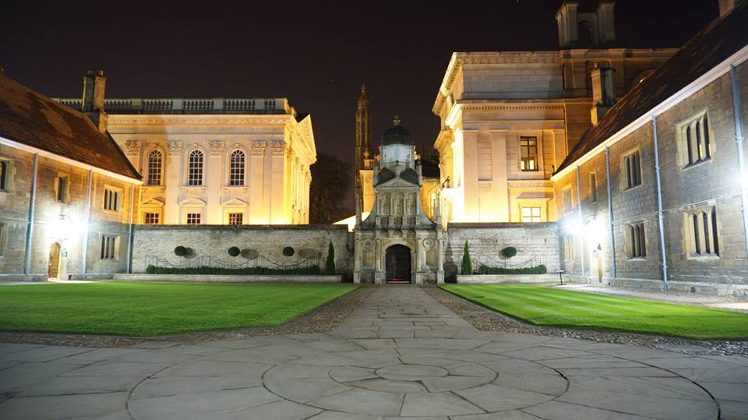
Caius Science Network
The Lent 2023
CSN informal talks
20:45, March 14th, Long Room
Open to all Caians
Fernando Quevedo – “String cosmology: from early universe to today”
A brief overview will be given about how string theory addresses some of the open questions regarding the early history of our universe and the accelerated expansion we observe today.
Zoë Fritz – “Resuscitation, ReSPECT and empirical ethics”
How medical ethics and the empirical method can change medical practice.
The meeting will be also on Zoom: https://us06web.zoom.us/j/87337464210?pwd=ZHhrNEl6V0wzK3lDK1RUOUVSVmhudz09
(copy or, if easier, email me for the link before lunch on the day)
Meeting ID: 873 3746 4210
Passcode: 16K2Nd
For details and announcements about the CSN meetings, visit: http://rafi.blumenfeld.co.uk/CSN/CSN.html

